Slide 1
Java: Objects

Slide 2
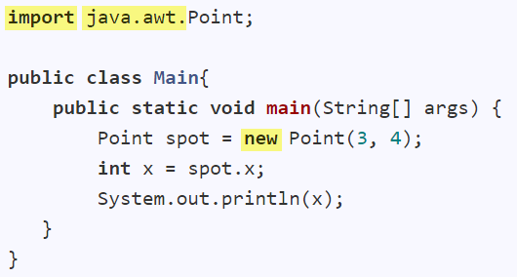

Package containing the Point class
Creates an object
Accesses an attribute of the object
Invokes method of the object
Java uses dot notation to access object members

Slide 3
What is the output?

Slide 6
Parameters
Arguments
Arguments are assigned to parameters.

Slide 7
Parameters
Arguments
Objects: passed by reference (i.e., the same object)
Primitives: passed by value (i.e., a copy)

Slide 8
x = 5
y = 0

Slide 9
x = 5
y = 5

Slide 10
x = 1
y = 1
x = 5
y = 5

Slide 11
x = 1
y = 1
7
x = 5
y = 5

Slide 12
x = 1
y = 1
7
x = 5
y = 5

Slide 13
x = 1
y = 1
7
x = 5
y = 5
What is the output?
(0, 0)
(1, 1)
(5, 5)

Slide 14
x = 1
y = 1
7
x = 5
y = 5
What is the output?
5
7

Slide 15
x = 1
y = 1
7
x = 5
y = 5
Objects: passed by reference (i.e., the same object)
Primitives: passed by value (i.e., a copy)

Slide 16

Garbage Collection
Java Garbage Collector will run periodically to remove unused objects.
This means the object is no longer used

Slide 17
x = 1
y = 1
7
x = 5
y = 5
p is ready to be garbage collected!

Slide 18
Java: Objects
Java uses dot notation to access object members
Objects: passed by reference (i.e., the same object)
Primitives: passed by value (i.e., a copy)
Java Garbage Collector will run periodically to remove unused objects.

Slide 19

Java: Classes

Slide 20
A constructor
Refers to the current object
Another constructor
Refers to the other constructor
A getter method
A setter method

Slide 22
Attributes

Slide 23
Attributes
A constructor

Slide 24
Attributes
A constructor
Refers to the current object

Slide 25
Attributes
A constructor
Refers to the current object
Another constructor
Refers to the other constructor

Slide 26
Attributes
A constructor
Refers to the current object
Another constructor
Refers to the other constructor
A getter method

Slide 27
Attributes
A constructor
Refers to the current object
Another constructor
Refers to the other constructor
A getter method
A setter method

Slide 28
Java: Class level members

Slide 29
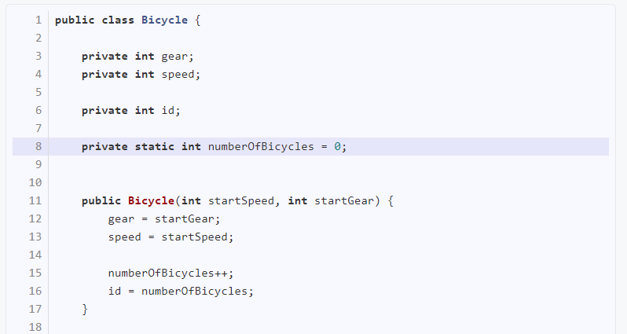

Slide 30
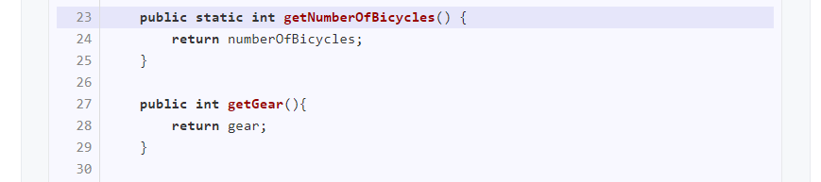

Slide 31
Bicycle b = new Bicycle(0, 1);
System.out.println(b.getNumberOfBicycles());
System.out.println(Bicycle.getNumberOfBicycles());

Slide 32
Java: Class level members
To make something class level use static keyword
To access a class level member, use the class name

